Slide 1

Housing Price Prediction Project
Submitted by:
Aaluri Krishnaveni Reddy

Slide 2
Problem Statement
Houses are one of the necessary need of each and every person around the globe and therefore housing and real estate market is one of the markets which is one of the major contributors in the world's economy. It is a very large market and there are various companies working in the domain. Data science comes as a very important tool to solve problems in the domain to help the companies increase their overall revenue, profits, improving their marketing strategies and focusing on changing trends in house sales and purchases. Predictive modelling, Market mix modelling, recommendation system are some of the machine learning techniques used for achieving the business goals for housing companies. Our problem is related to one such housing company.
A US-based housing company named Surprise Housing had decided to enter the Australian market. The company uses data analytics to purchase houses at a price below their actual values and flip them at a higher price. For the same purpose, the company has collected a data set from the sale of houses in Australia. The data is provided in the CSV file below.
The company is looking at prospective properties to buy houses to enter the market. You are required to build a model using Machine Learning in order to predict the actual value of the prospective properties and decide whether to invest in them or not. For this company wants to know:
Business Goal:
You are required to model the price of house with the available independent variables. This model will then be used by the management to understand how exactly the prices vary with the variables. They can accordingly manipulate the strategy of the firm and concentrate on areas that will yield high returns. Further, the model will be a good way for the management to understand the pricing dynamics of a new market.

Slide 3
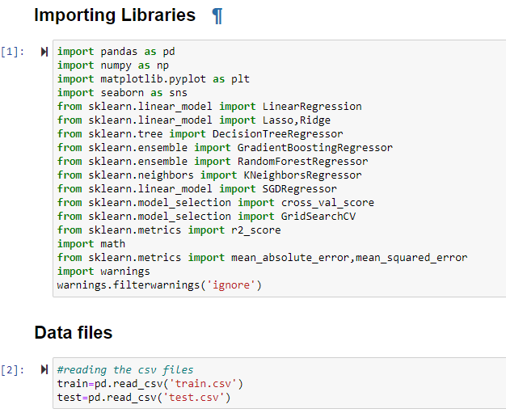
Importing libraries and Importing the data
Importing the important libraries to do process
After importing the libraries we need to read our data files, which we have to solve and give our best conclusion.
As per our data this is a regression problem
Here we have 2 data sets one is for train the data and another one is to test the data and get the predicted results for target variable

Slide 4
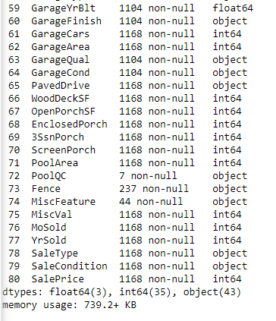
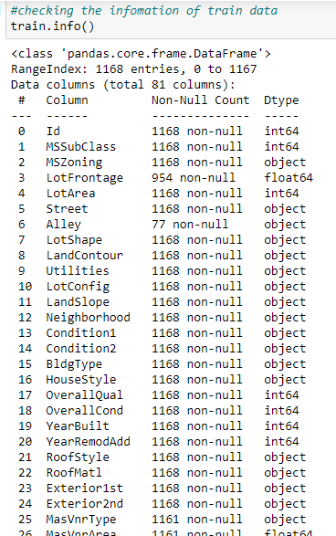
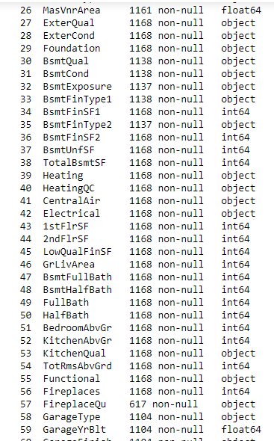
Using info function
Info() function is give the information about the datasets
We have 81 columns and 1168 entries ,
It gives rough information about the data sets like columns names, and dtypes, non-null values and count of dtypes and memory size in bottom

Slide 5
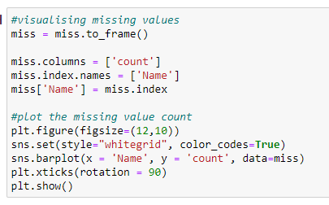
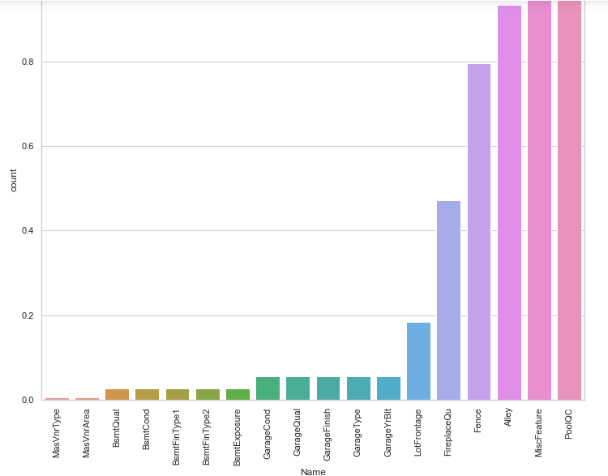
As next step we find the null values in each column by using isnull().sum() function
plot shows the null values in the data sets if we have null values more then we have to remove that columns because it is no use
If we have 75% above entries are null values in any column then we have to drop those columns

Slide 6
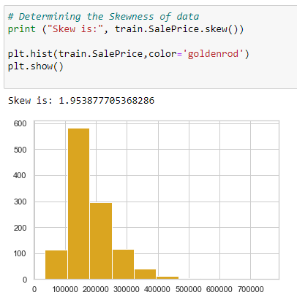
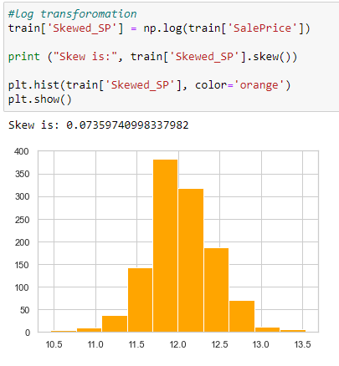
Outliers in the target variable
Target variable is right skewed so I try to remove the skewness by using the log transformation
By that I got clear the skewness in the data

Slide 7
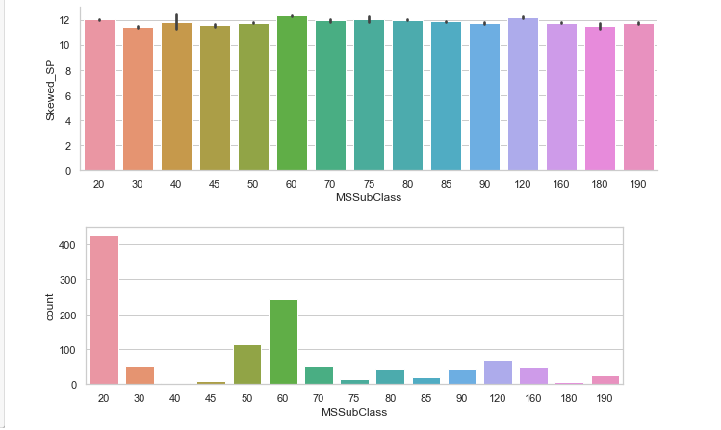
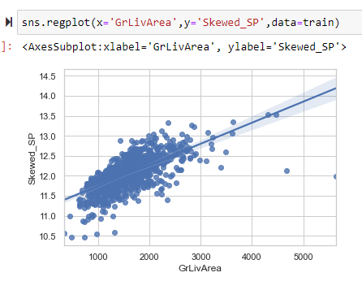
Some more visualization plots
Plot shows the values of MSSubClass with sales price as priority of the class
And next plot show the values count of the MSSubClass column
SalePrice increases as the GrLivArea increases. We will also get rid of the outliers which severely affect the prediction of the survival rate.

Slide 8
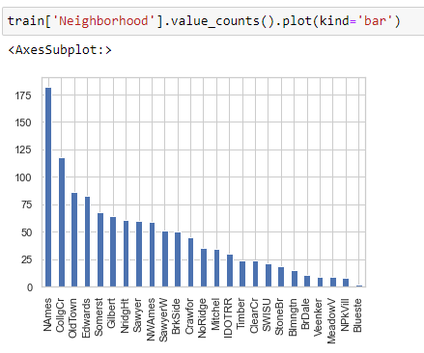
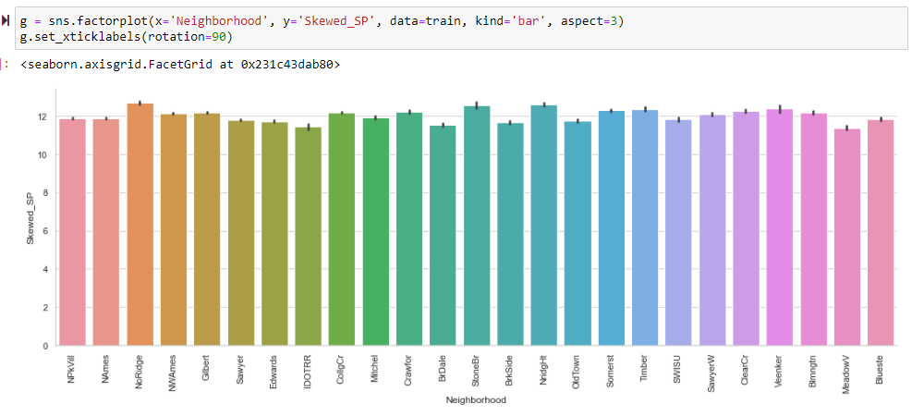
Plot shows the neighbor hood of the house which comparing the price of house

Slide 9
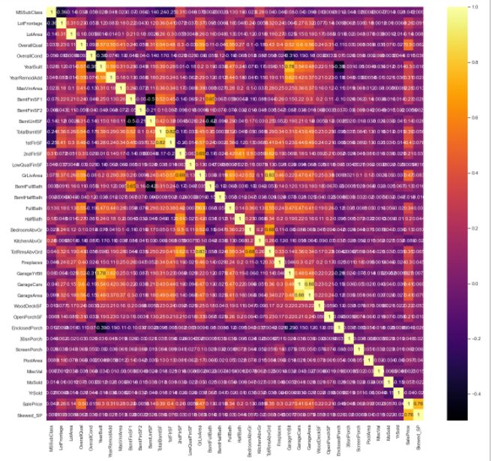
Correlation
Checking the correlation with the heat map, we have so many columns because of these we can’t find which has good correlation and which has zero correlation with the target variable

Slide 10
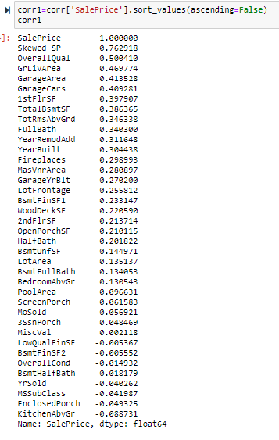
By this code we got know that we have 8 columns with least correlation with the target variable so I decide those are not giving any impact on target variable so I am dropping those columns from the data frames

Slide 11
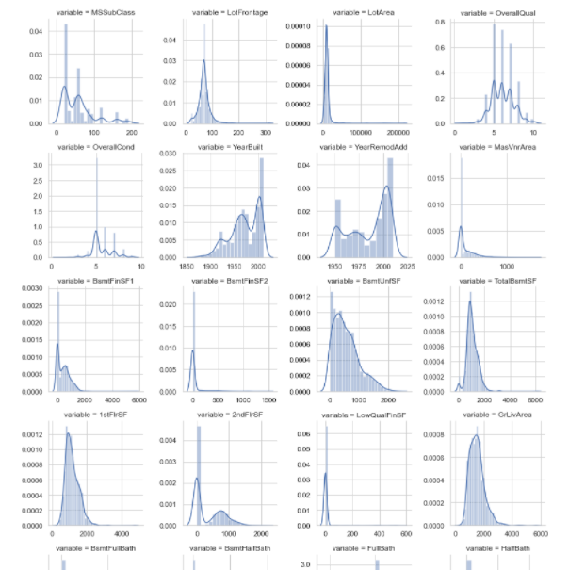
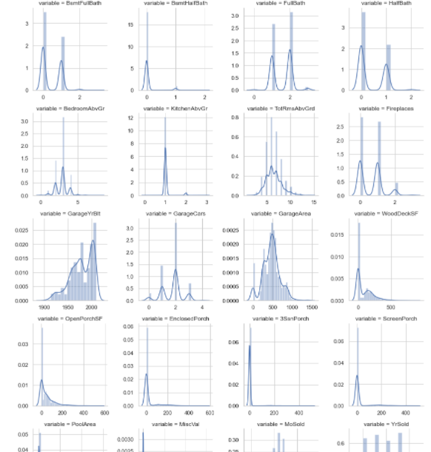
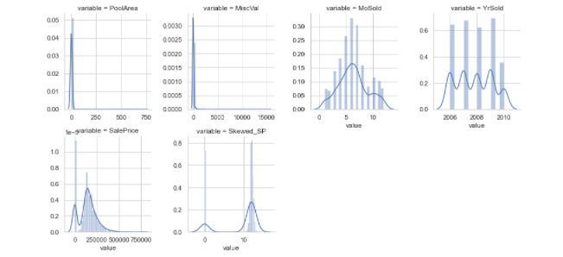
Plots are about to checking the distribution of the data in the numerical columns,
We can see all the columns has right skewed so I try to use log transformation but it gives no change then I use the zscore techniques it removed the out liers and skewness in the data

Slide 12
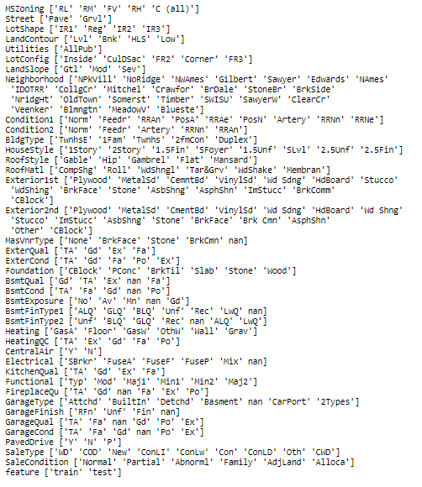
Object dtype columns
Checking the object dtype columns, data distribution in the columns and how many unique values are in the columns
As next step check with is necessary to data and if not use full drop those columns
And next we have to convert into numerical by using encoding techniques
As next step train_test_split the data to prepare the models

Slide 13
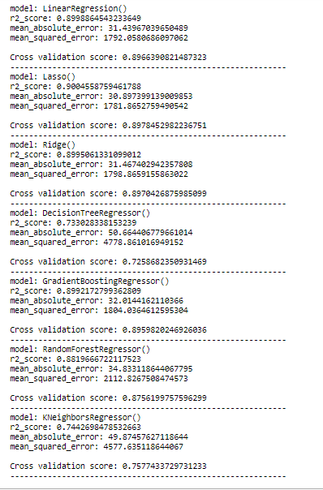
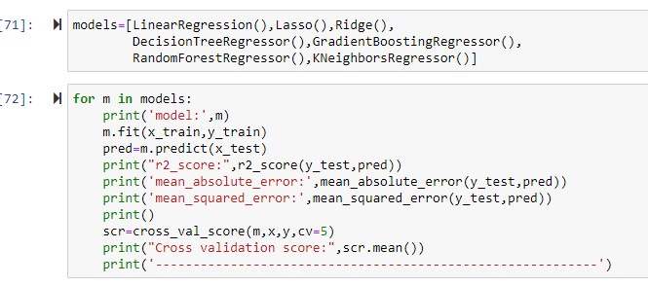
Model building
After applying different machine learning algorithms I decided ridge is the best model for this problem

Slide 14
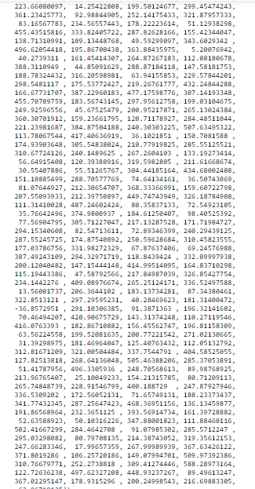
Prediction values
We have 2 data sets one is for training and one is for testing
In above steps we are developed and train the model to give the best values
After build the best model we need to test the model with the test data set and it gives the prediction values for the test data frame

Slide 15
Conclusion
The Sale price depends on the following features:
The most important to decide the price is constructing year and quality and location
Area of the house is located, city or a street
If it is old construction it may change the price by remodification
The size and shape of lot
central air conditioning facility
Floors of contraction, if the house in 1st or 2nd floor it may differ as per the construction
Quality of kitchen
Total no. of rooms in house
Electrical type
Whether driveway is paved.
Wood deck, screen parch, pool area
No. of Fire place in the house
Garage area and overall construction quality
condition of sale
Thank you

